Slide 1


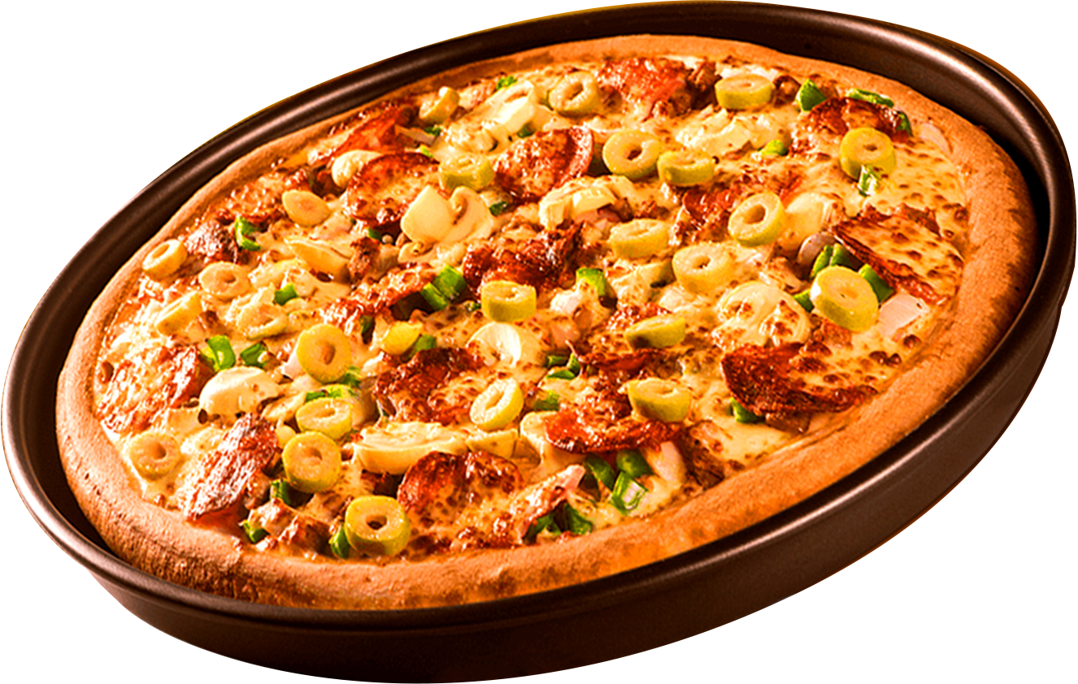
SQL PROJECT ON PIZZA SALES

Slide 2
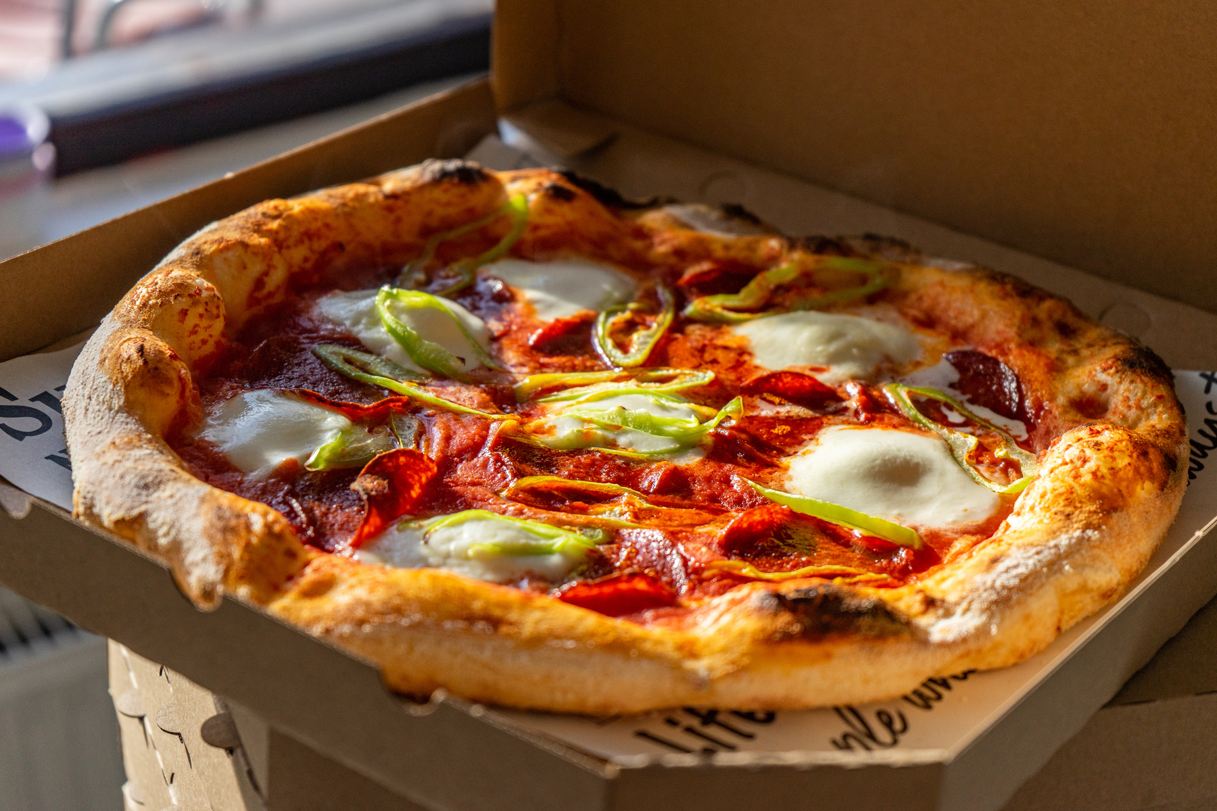
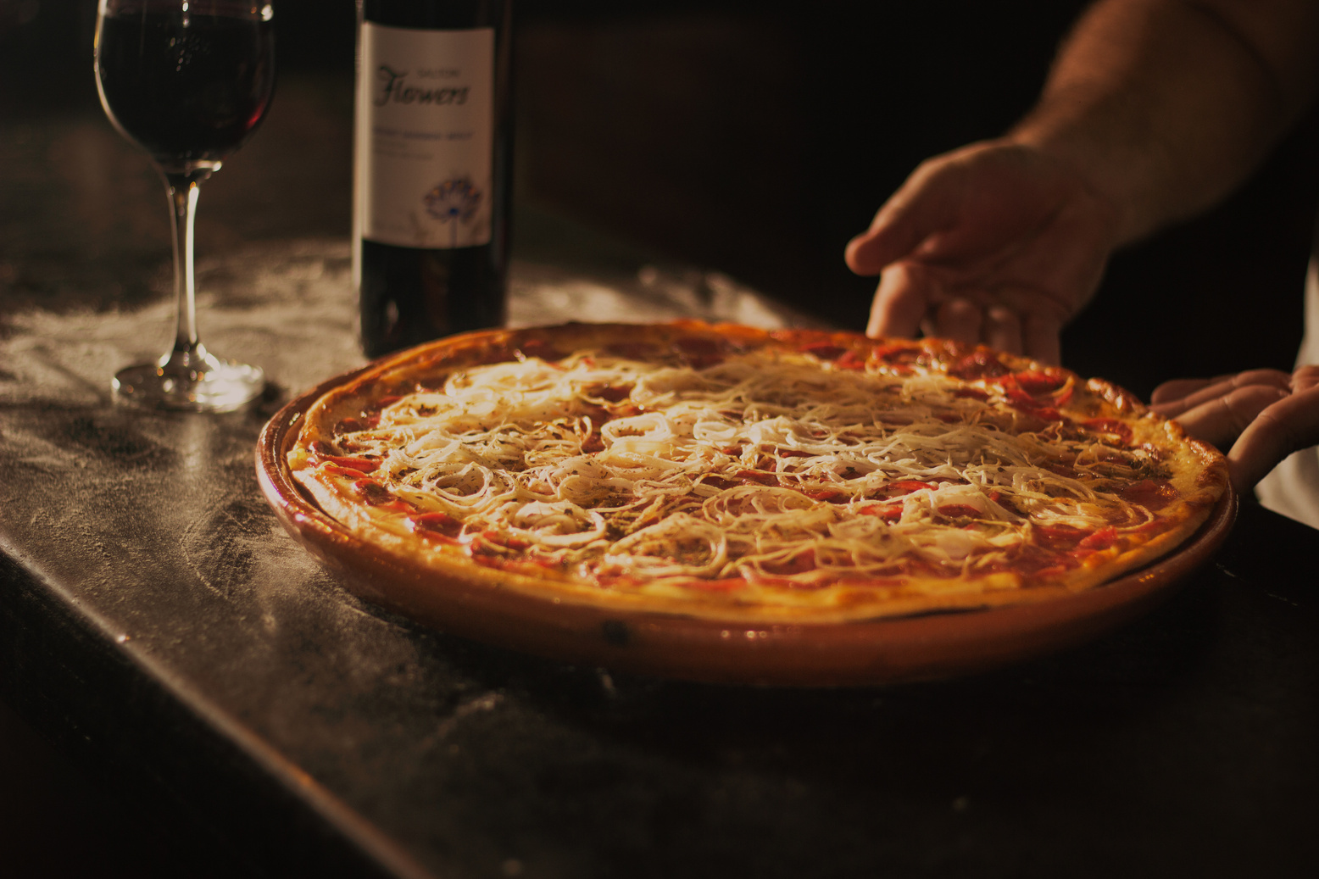
About
The Pizza Sales dataset is structured across four different files, each capturing essential aspects of the sales process.
The order details file contains records with `order_id`, `pizza_id`, and `quantity`, allowing you to track how many of each pizza type was ordered per transaction.
The orders file provides additional context for each order, specifying the `order_id`, `date`, and `time` the order was placed.
The pizza types file offers insight into the characteristics of each pizza, listing the `pizza_type`, its `name`, `category` (such as vegetarian or non-vegetarian), and `ingredients` used.
Finally, the pizzas file links the `pizza_id` to a specific `pizza_type`, `size`, and `price`, enabling analysis of different pizza offerings and their sales performance by size and price. Together, these files provide a comprehensive view of pizza sales, from individual order details to pizza descriptions and pricing.

Slide 3
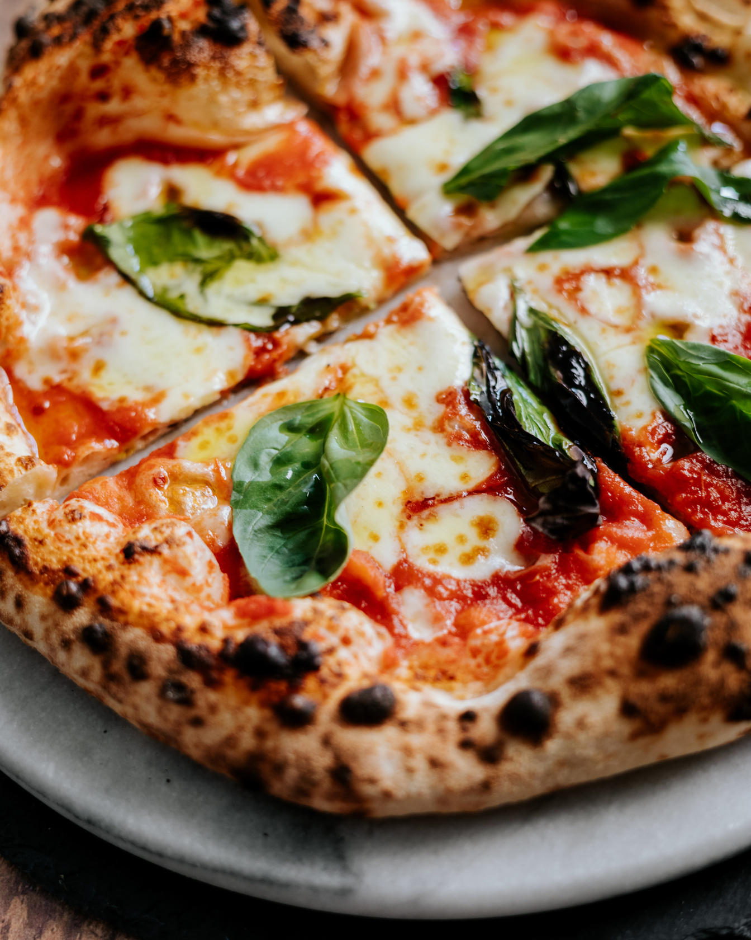
Questions:
Basic:
Retrieve the total number of orders placed.
Calculate the total revenue generated from pizza sales.
Identify the highest-priced pizza.
Identify the most common pizza size ordered.
List the top 5 most ordered pizza types along with their quantities.
Intermediate:
Join the necessary tables to find the total quantity of each pizza category ordered.
Determine the distribution of orders by hour of the day.
Join relevant tables to find the category-wise distribution of pizzas.
Group the orders by date and calculate the average number of pizzas ordered per day.
Determine the top 3 most ordered pizza types based on revenue.
Advanced:
Calculate the percentage contribution of each pizza type to total revenue.
Analyze the cumulative revenue generated over time.
Determine the top 3 most ordered pizza types based on revenue for each pizza category.

Slide 4
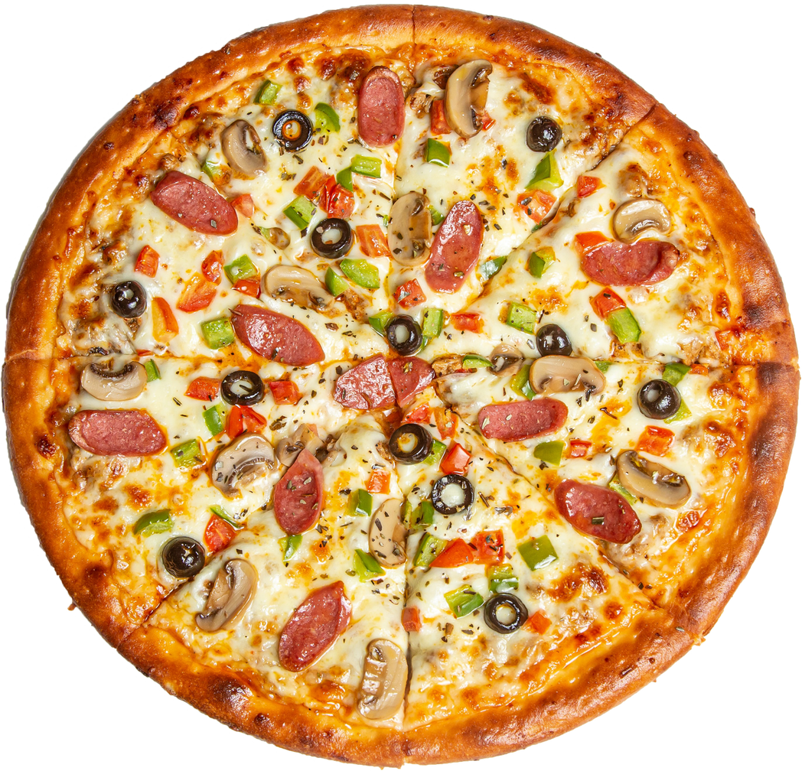
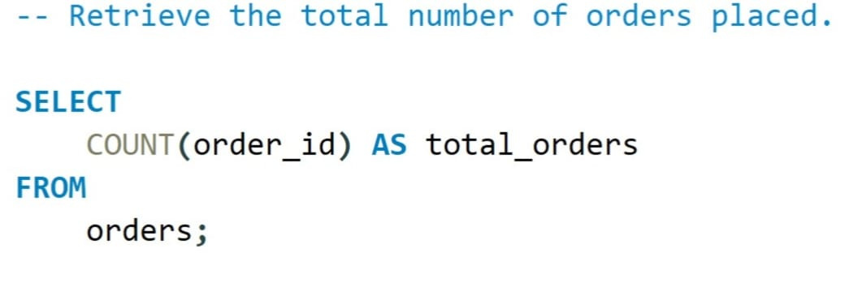
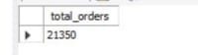

Slide 5
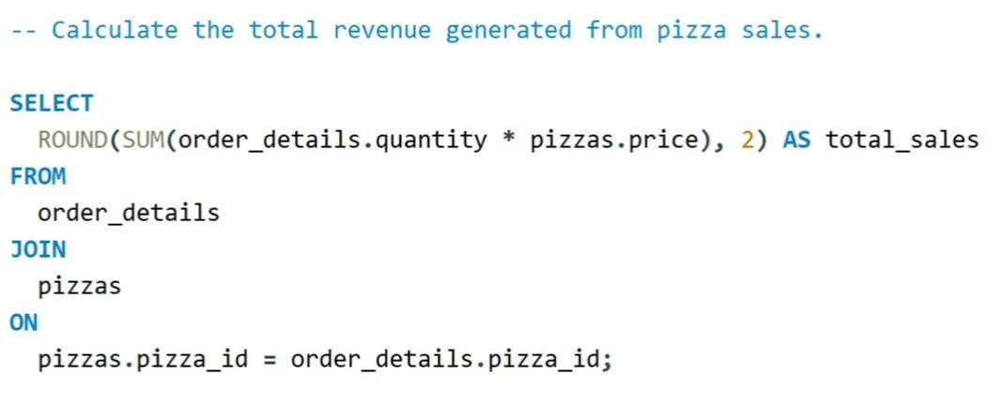
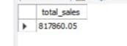

Slide 6
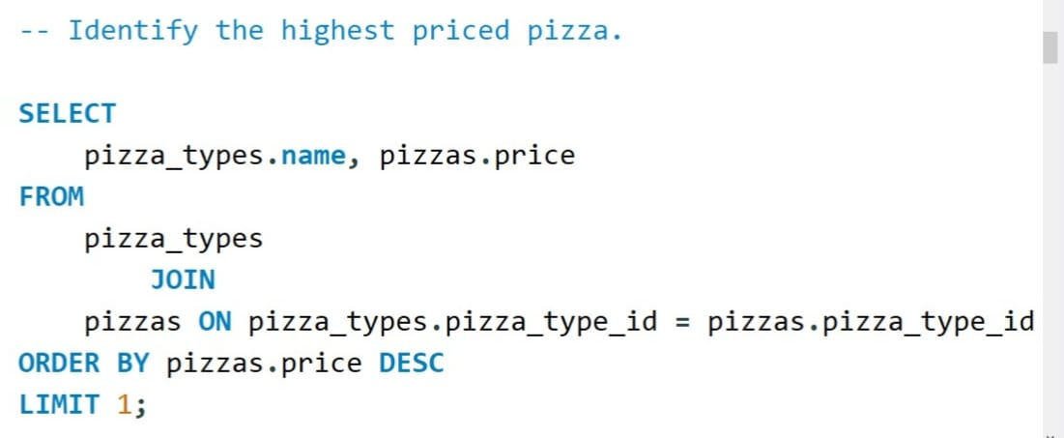
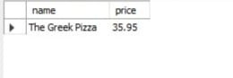

Slide 7
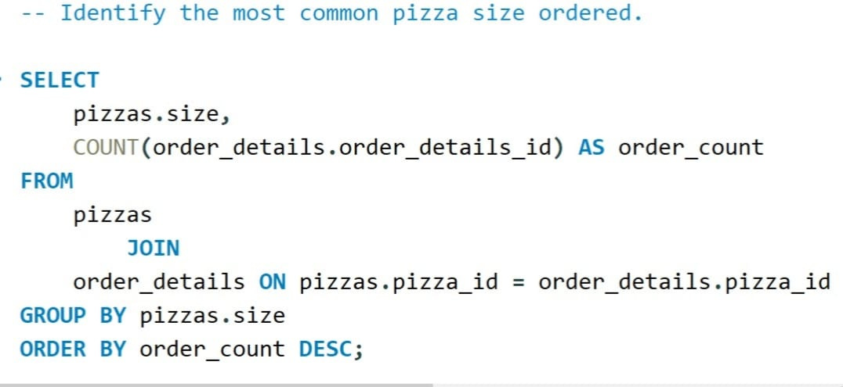
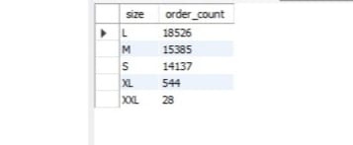

Slide 8
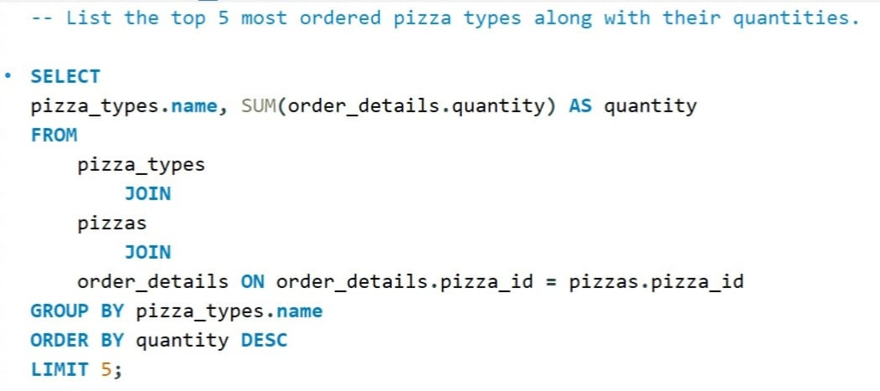
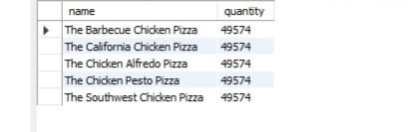

Slide 9
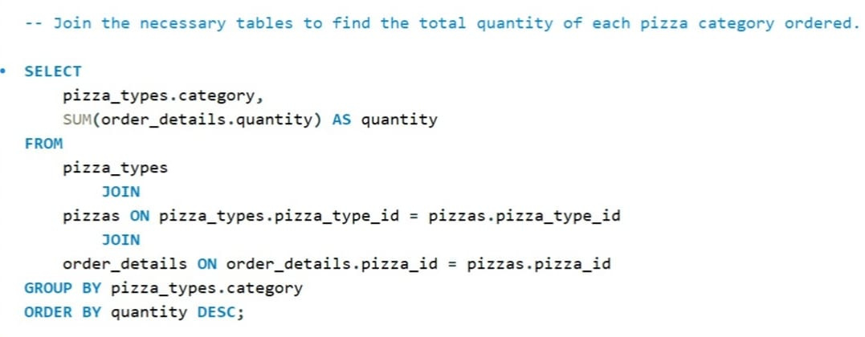
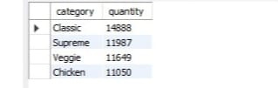

Slide 10
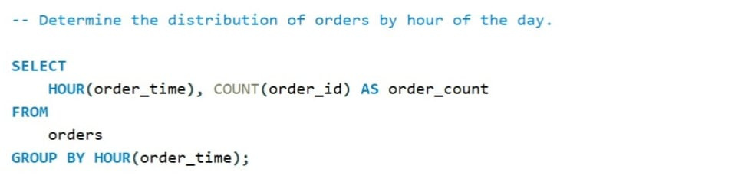
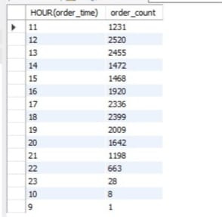

Slide 11
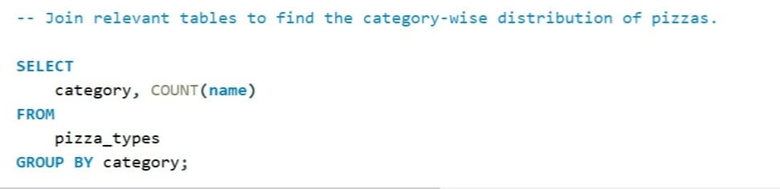
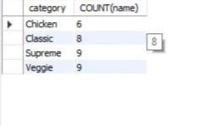

Slide 12
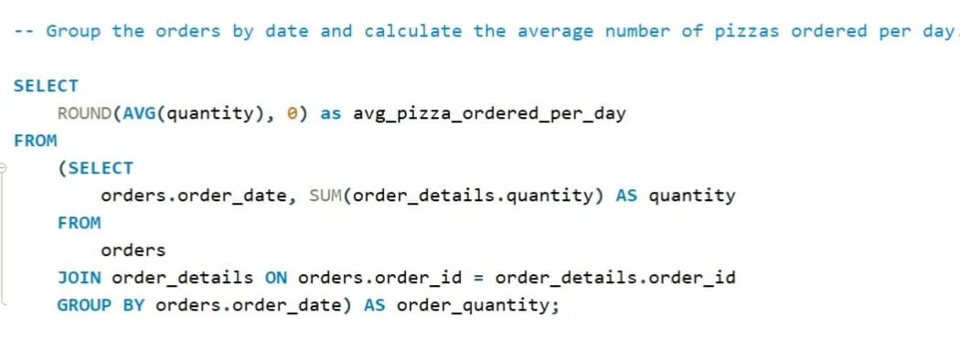
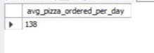

Slide 13
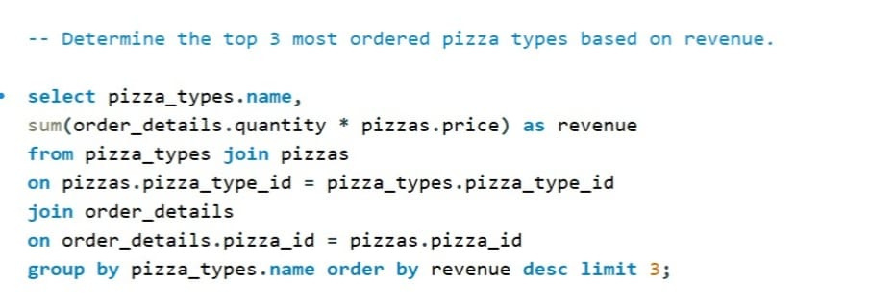
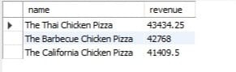

Slide 14
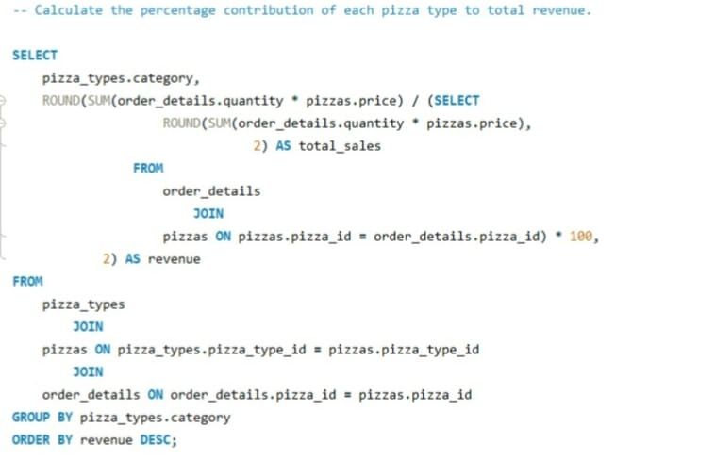
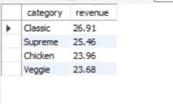

Slide 15
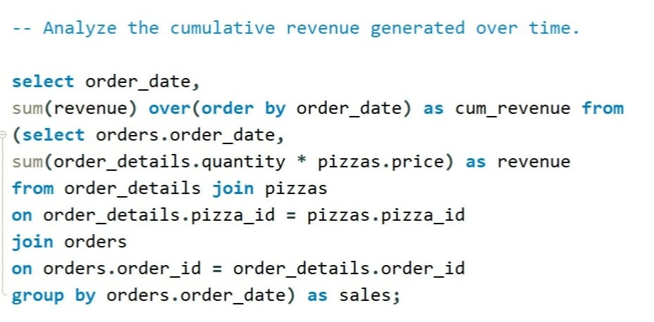
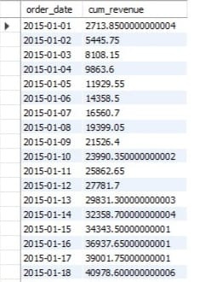

Slide 16
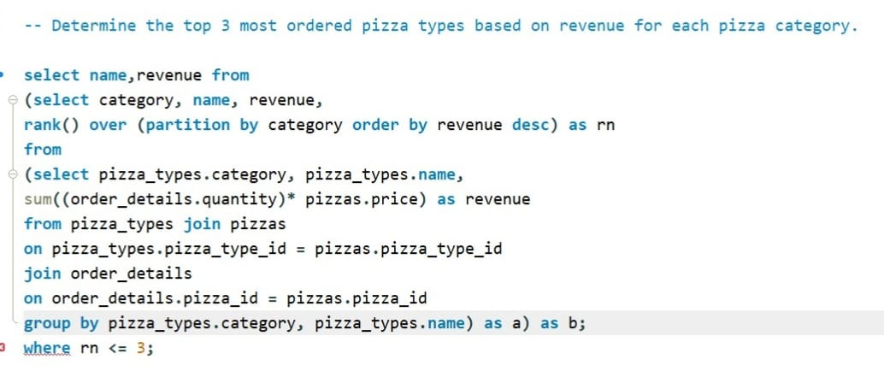
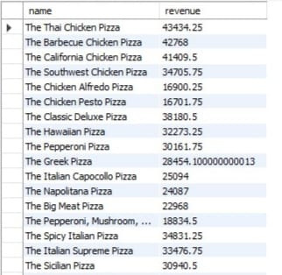

Slide 17
Pizza Sales Presentation
THANK YOU
https://www.linkedin.com/in/hrithik-muthanna-35a2a3273

